Slide 1
AN INTERNSHIP PROGRAM ON PYTHON DEVELOPMENT (REMOTE)
Under Supervision: ANJALI P Director & CEO
Internship Coordinator: Prof. BIDISHA PAL
Name : SHIVANAND SATYAPPA NASHI
UUCMS No: U03AD21S0030

Slide 2
AGENDA
1
2
3
4
5
About Topic
About Company
SRS
Designing
Coding
Conclusion

Slide 3
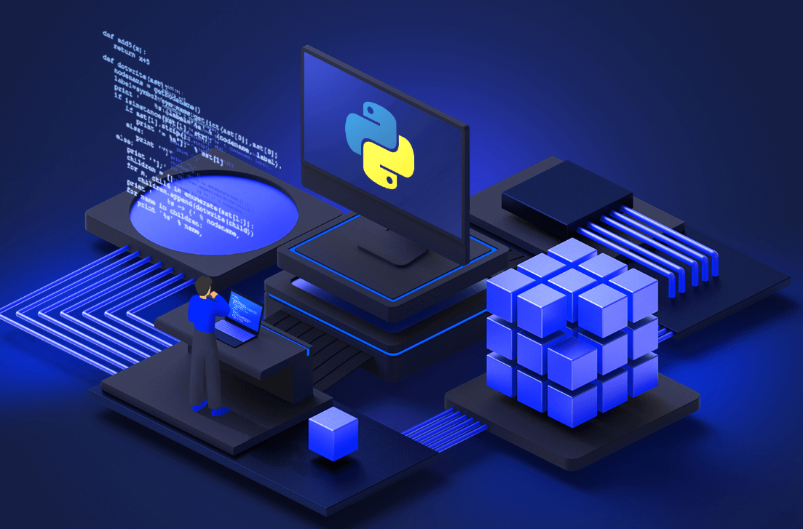
PYTHON DEVELOPMENT

Slide 4

TECH_OCTANET SERVICES PVT LTD, Bhubaneswar, Odisha
ABOUT THE COMPANY

Slide 5
TECH_OCTANET SERVICES PVT LTD, Bhubaneswar, Odisha
At OctaNet Services Pvt Ltd., we're at the forefront of cutting-edge IT software development in addition, we provide corporate training to a variety of students who are interested. We combine innovation with excellence, aiming to redefine the technology landscape. We are a forward thinking, fast-paced, and dynamic IT software company that believes in pushing boundaries and setting new standards. We're looking for a Business Development Trainee to help us expand our reach and drive the growth of our solutions.
Contact Details:
Head Office Address: Bangalore, India Bhubaneswar, India
Phone: +91 7789001085
Email: support@octanet.in
Website https://www.octanet.in
LinkedIn https://www.linkedin.com/company/octanetsolutions/
PROGRAMMERS AND OPPORTUNITIES:
Web development
Python Development
Android Development
Java Development
Cloud Computing

Slide 6
Responsibilities:
Creating web pages using frontend technologies (HTML CSS and JavaScript etc.)
Maintain and develop server side using backend technologies (python, Java, and Django etc.)
Benefits and perks:
Certificate of Internship.
Letter of recommendation.
Guidance from Expert Trainers.
Job/Placement Assistance.

Slide 7
Objectives of Internship:
Internships are generally thought of to be reserved for college students looking to gain experience in a particular field. However, a wide array of people can benefit from Training Internships to receive real world experience and develop their skills.
An objective for this position should emphasize the skills you already possess in the area and your interest in learning more.
Internships are utilized in several different career fields, including architecture, engineering, healthcare, economics, advertising and many more.
Some internship is used to allow individuals to perform scientific research while others are specifically designed to allow people to gain first-hand experience working.
Utilizing internships is a great way to build your resume and develop skills that can be emphasized in your resume for future jobs. When you are applying for a Training Internship, make sure to highlight any special skills or talents that can make you stand apart from the rest.

Slide 8
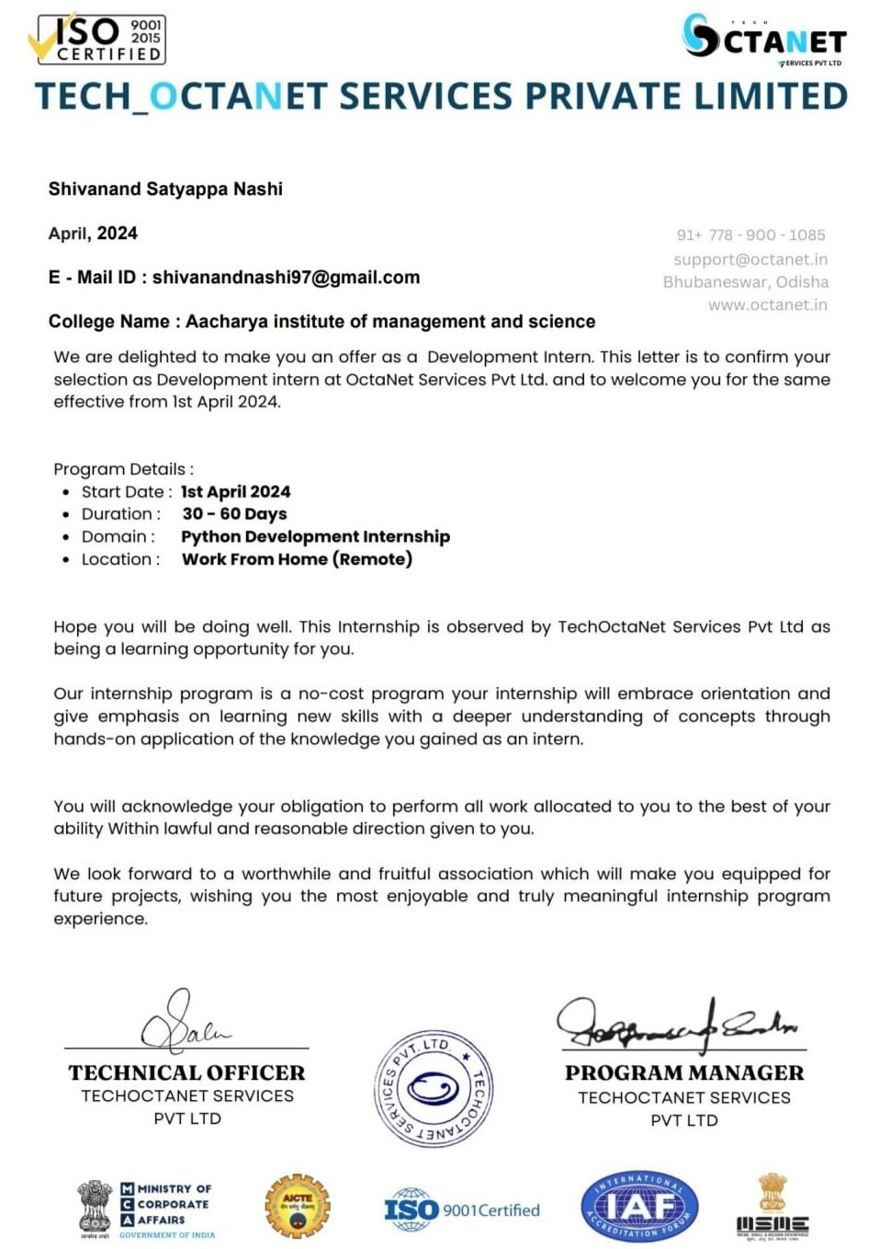
INTERNSHIP OFFER LETTER

Slide 9
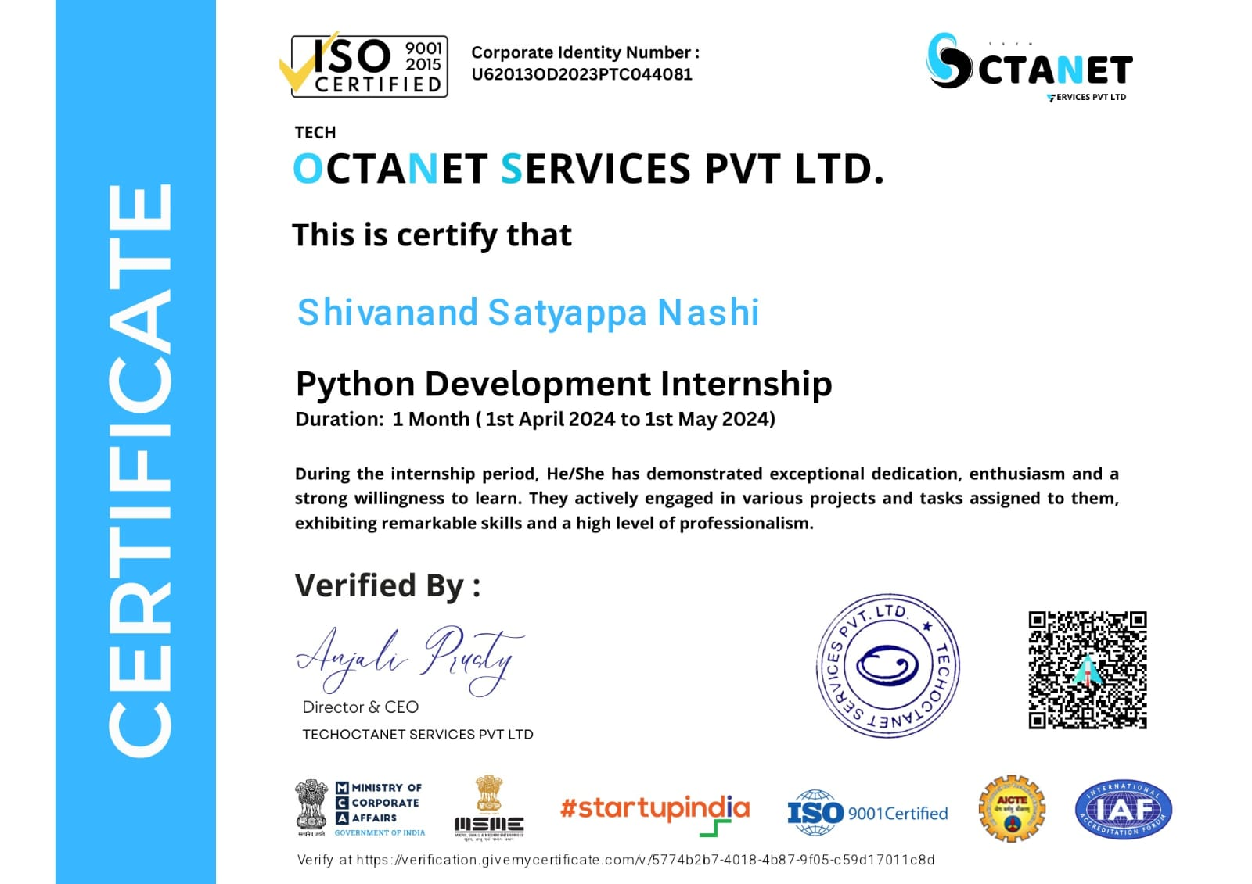
INTERNSHIP CERTIFICATE

Slide 10
SYSTEM REQUIREMENTS SPECIFICATIONS
PURPOSE:
The purpose of this document is to define the software requirements for the ATM (Automated Teller Machine) interface console. This document serves as a comprehensive guide for stakeholders involved in the design, development, testing, and maintenance of the ATM interface console software.
SCOPE:
The scope of a Python development program encompasses foundational to advanced programming skills, preparing learners for diverse roles in software development, data science, web development, automation, and artificial intelligence. It includes mastering Python syntax, data structures, object-oriented programming, web frameworks like Django and Flask, and data analysis tools like Pandas and NumPy. Additionally, it covers best practices in coding, testing, version control, and project management. The program aims to equip learners with the necessary knowledge and hands-on experience to develop efficient, scalable applications and succeed in a variety of technical careers.
PROJECT FEASIBILITY STUDY:
Technical Feasibility: The system is a web-based application with client-server architecture. Efforts are made to ensure timely rendering of pages by optimizing code.
Economic Feasibility: The project is cost-effective, with tangible costs easily determinable. Intangible costs are minimal.
Operational Feasibility: Operational feasibility is ensured by the system’s web support feature, which caters to organizational aspects effectively.

Slide 11
Definitions, Acronyms, and Abbreviations:
ATM: Automated Teller Machine
SRS: Software Requirements Specification
PIN: Personal Identification Number
GUI: Graphical User Interface
Hardware Requirements:
Operating System
Windows: Windows 11
Python Interpreter
Version: Python 3.7 or later (Python 3.10+ recommended)
Distribution: Standard Python distribution from python.org or Anaconda for scientific computing

Slide 12
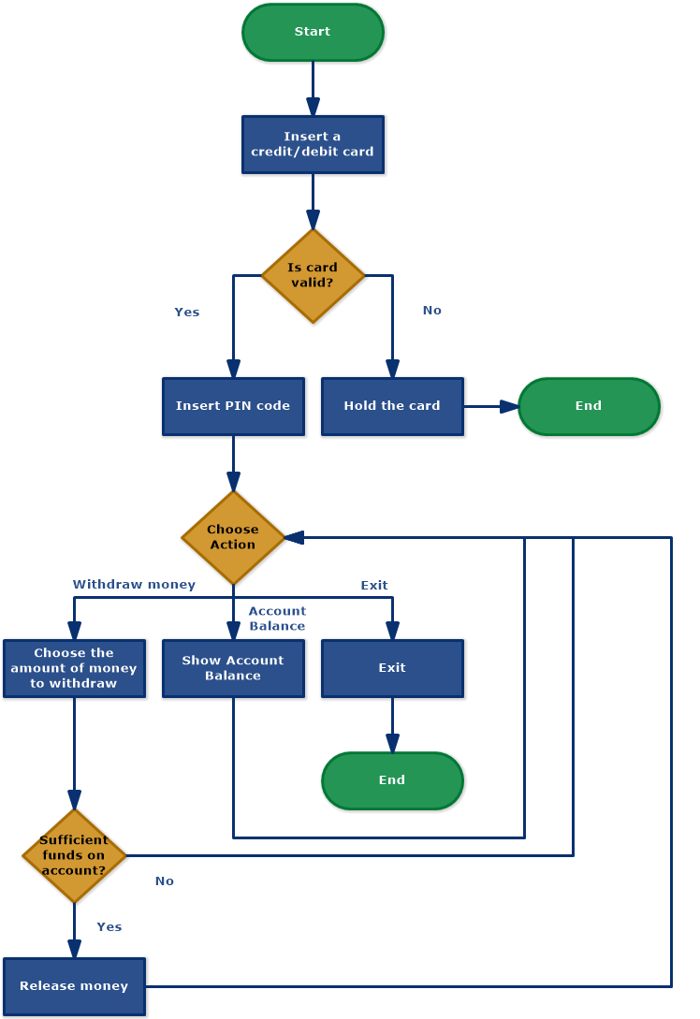
DESIGNING FLOWCHART OF TASK

Slide 13
CODING
TASK DESCRIPTION:
ATM INTERFACE :
The ATMs in our cities are built on Python, as we have all seen them. It is a console-based application with five different classes. In order to use the system, the user must enter his or her user ID and pin when it starts. Once the details are entered successfully, ATM functionality is unlocked. As a result of the project, the following operations can be performed:
Transactions
History
Withdraw
Deposit
Transfer
Quit

Slide 14
Coding:
Creating an ATM interface using Python involves implementing a simple console-based application that mimics the basic functionalities of an ATM, such as account balance inquiry, withdrawal, deposit, and exit options. Below is a step-by-step guide and the corresponding code for building this interface.
Step-by-Step Guide:
1. Define the ATM class: The class will encapsulate all the functionalities and state of the ATM, including account balance and methods for different transactions.
2. Initialize the ATM: The constructor (`__init__` method) will initialize the account balance.
3. Create Methods for Transactions:
`check_balance()`: Method to check the current account balance.
`deposit(amount)`: Method to deposit an amount into the account.
`withdraw(amount)`: Method to withdraw an amount from the account.
`exit_atm()`: Method to exit the ATM interface.
4. Implement the User Interface: A loop that provides a menu for the user to select different options and calls the corresponding methods based on user input.

Slide 15
EXPLANATION OF THE CODE:
1. ATM Class Definition: The `ATM` class encapsulates the functionalities of the ATM. The initial balance is set to $1000 for demonstration purposes.
2. Methods:
`check_balance()`: Prints the current balance.
`deposit(amount)`: Adds the specified amount to the balance if the amount is valid.
`withdraw(amount)`: Subtracts the specified amount from the balance if the amount is valid and sufficient funds are available.
`exit_atm()`: Exits the program with a goodbye message.
3. Main Function:
The `main()` function creates an instance of the `ATM` class and provides a menu-driven interface for the user.
A `while` loop ensures the menu is repeatedly displayed until the user chooses to exit.
-The user’s choice is obtained using `input()`, and the corresponding method of the `ATM` class is called based on the input.
- The `if-elif-else` structure handles the user’s choice and validates the input.
CODE : https://github.com/Gtshivanand/Task-On-AtmInterface.git//

Slide 16
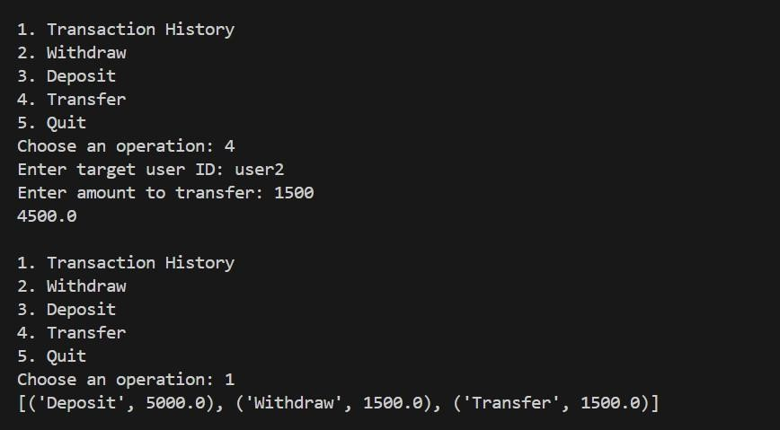
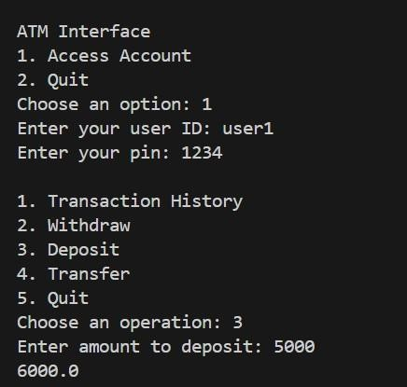
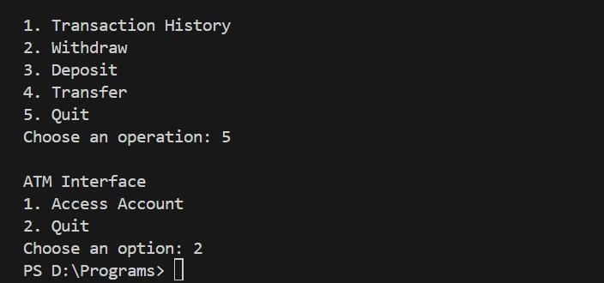
OUTPUT

Slide 17
CONCLUSION
In conclusion, a Python development program equips learners with essential skills to navigate the dynamic landscape of software engineering. By mastering Python's versatile syntax, libraries, and frameworks, developers gain proficiency in creating diverse applications—from web development and data analysis to machine learning and automation.
Through hands-on projects and rigorous testing practices, this program fosters critical thinking, problem-solving abilities, and a solid understanding of best practices. Ultimately, graduates are well-prepared to tackle real-world challenges, innovate effectively, and contribute meaningfully to both individual projects and collaborative teams in the ever-evolving field of technology.

Slide 18
THANK YOU!!!

